Slide 1

Clustering
Chapter 10

Slide 2
Outline
What is Clustering?
K-Means Clustering
Hierarchical Clustering

Slide 3
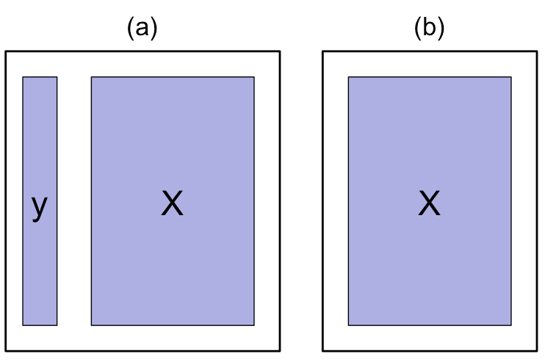
Supervised vs. Unsupervised Learning
Supervised Learning: both X and Y are known
Unsupervised Learning: only X
Supervised Learning
Unsupervised Learning

Slide 4
Clustering
Clustering refers to a set of techniques for finding subgroups, or clusters, in a data set.
A good clustering is one when the observations within a group are similar but between groups are very different
For example, suppose we collect p measurements on each of n breast cancer patients. There may be different unknown types of cancer which we could discover by clustering the data

Slide 5
Different Clustering Methods
There are many different types of clustering methods
We will concentrate on two of the most commonly used approaches
K-Means Clustering
Hierarchical Clustering

Slide 6
K-Means Clustering
To perform K-means clustering, one must first specify the desired number of clusters K
Then the K-means algorithm will assign each observation to exactly one of the K clusters

Slide 7
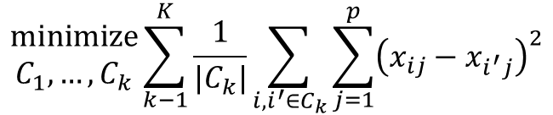
How does K-Means work?
We would like to partition that data set into K clusters
Each observation belong to at least one of the K clusters
The clusters are non-overlapping, i.e. no observation belongs to more than one cluster
The objective is to have a minimal “within-cluster-variation”, i.e. the elements within a cluster should be as similar as possible
One way of achieving this is to minimize the sum of all the pair-wise squared Euclidean distances between the observations in each cluster.
$$\begin{matrix}minimize \\ C_{1},…,C_{k}\end{matrix}\sum_{k−1}^{K}{\frac{1}{|C_{k}|}\sum_{i,i^{′}∈C_{k}}{\sum_{j=1}^{p}{{\left(x_{ij}−x_{i^{′}j}\right)}^{2}}}}$$

Slide 8
K-Means Algorithm
Initial Step: Randomly assign each observation to one of K clusters
Iterate until the cluster assignments stop changing:
For each of the K clusters, compute the cluster centroid. The k^{th} cluster centroid if the mean of the observations assigned to the k^{th} cluster
Assign each observation to the cluster whose centroid is closest (where “closest” is defined using Euclidean distance.

Slide 9
An Illustration of the K-Means Algorithm
Random Assignment of points
Compute cluster centers from initial assignments
Computer new cluster centers
Assign points to closest cluster center
Now there is no further change so stop

Slide 10
Local Optimums
Bad Solution
Good Solution
The K-means algorithm can get stuck in “local optimums” and not find the best solution
Hence, it is important to run the algorithm multiple times with random starting points to find a good solution

Slide 11
Hierarchical Clustering
K-Means clustering requires choosing the number of clusters.
If we don’t want to do that, an alternative is to use Hierarchical Clustering
Hierarchical Clustering has an added advantage that it produces a tree based representation of the observations, called a Dendogram

Slide 12
Dendograms
First join closest points (5 and 7)
Height of fusing/merging (on vertical axis) indicates how similar the points are
After the points are fused they are treated as a single observation and the algorithm continues

Slide 13
Interpretation
Each “leaf” of the dendogram represents one of the 45 observations
At the bottom of the dendogram, each observation is a distinct leaf. However, as we move up the tree, some leaves begin to fuse. These correspond to observations that are similar to each other.
As we move higher up the tree, an increasing number of observations have fused. The earlier (lower in the tree) two observations fuse, the more similar they are to each other.
Observations that fuse later are quite different

Slide 14
Choosing Clusters
To choose clusters we draw lines across the dendogram
We can form any number of clusters depending on where we draw the break point.
One Cluster
Two Clusters
Three Clusters

Slide 15
Algorithm (Agglomerative Approach)
The dendogram is produced as follows:
Start with each point as a separate cluster (n clusters)
Calculate a measure of dissimilarity between all points/ clusters
Fuse two clusters that are most similar so that there are now n-1 clusters
Fuse next two most similar clusters so there are now n-2 clusters
Continue until there is only 1 cluster

Slide 16
An Example
Start with 9 clusters
Fuse 5 and 7
Fuse 6 and 1
Fuse the (5,7) cluster with 8.
Continue until all observations are fused.

Slide 17
How do we define dissimilarity?
Implementing hierarchical clustering involves one obvious issue
How do we define the dissimilarity, or linkage, between the fused (5,7) cluster and 8?
There are four options:
Complete Linkage
Single Linkage
Average Linkage
Centriod Linkage

Slide 18
Linkage Methods: Distance Between Clusters
Complete Linkage: Largest distance between observations
Single Linkage: Smallest distance between observations
Average Linkage: Average distance between observations
Centroid: distance between centroids of the observations

Slide 19
Linkage Can be Important
Here we have three clustering results for the same data
The only difference is the linkage method but the results are very different
Complete and average linkage tend to yield evenly sized clusters whereas single linkage tends to yield extended clusters to which single leaves are fused one by one.

Slide 20
Choice of Dissimilarity Measure
So far, we have considered using Euclidean distance as the dissimilarity measure
However, an alternative measure that could make sense in some cases is the correlation based distance

Slide 21
Comparing Dissimilarity Measures
In this example, we have 3 observations and p = 20 variables
In terms of Euclidean distance obs. 1 and 3 are similar
However, obs. 1 and 2 are highly correlated so would be considered similar in terms of correlation measure

Slide 22
Online Shopping Example
Suppose we record the number of purchases of each item (columns) for each customer (rows)
Using Euclidean distance, customers who have purchases very little will be clustered together
Using correlation measure, customers who tend to purchase the same types of products will be clustered together even if the magnitude of their purchase may be quite different

Slide 23
Standardizing the Variables
Consider an online shop that sells two items: socks and computers
Left: In terms of quantity, socks have higher weight
Center: After standardizing, socks and computers have equal weight
Right: In terms of dollar sales, computers have higher weight

Slide 24
Practical Issues in Clustering
In order to perform clustering, some decisions must be made:
Should the features first be standardized? i.e. Have the variables centered to have a mean of zero and standard deviation of one.
In case of hierarchical clustering:
What dissimilarity measure should be used?
What type of linkage should be used?
Where should we cut the dendogram in order to obtain clusters?
In case of K-means clustering:
How many clusters should we look for the data?
In practice, we try several different choices, and look for the one with the most useful or interpretable solution. There is no single right answer!

Slide 25
Final Thoughts
Most importantly, one must be careful about how the results of a clustering analysis are reported
These results should not be taken as the absolute truth about a data set
Rather, they should constitute a starting point for the developments of a scientific hypothesis and further study, preferably on independent data

Slide 26
Exercise
Suppose that we have 5 observations, for which we compute a similarity (distance) matrix as follows:
On the basis of the similarity matrix, sketch the dendogram that results from hierarchically clustering these 5 observations using complete linkage.
 | A | B | C | D | E
A | 0
B | 9 | 0
C | 3 | 7 | 0
D | 6 | 5 | 9 | 0
E | 11 | 10 | 2 | 8 | 0

